Slide 1
Homework_4 - FEAT
報告者 : 朱偉華

Slide 2
Outline
Example real fmri-fluency dataset
Featquery
High-resolution Single-Session Overlays
Custom Waveforms

Slide 3
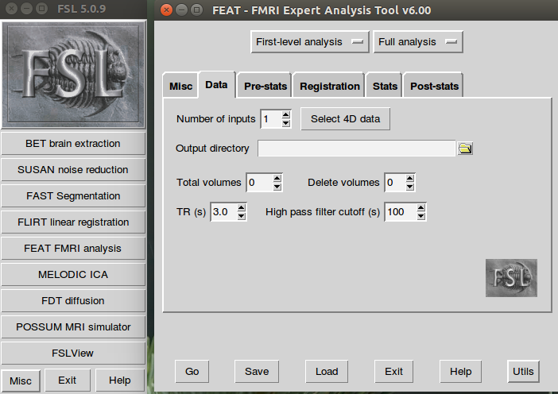
Example real fmri-fluency dataset
. /etc/fsl/5.0/fsl.sh
cd ~/fsl_course_data/fmri
cd fmri_fluency
Feat &

Slide 4
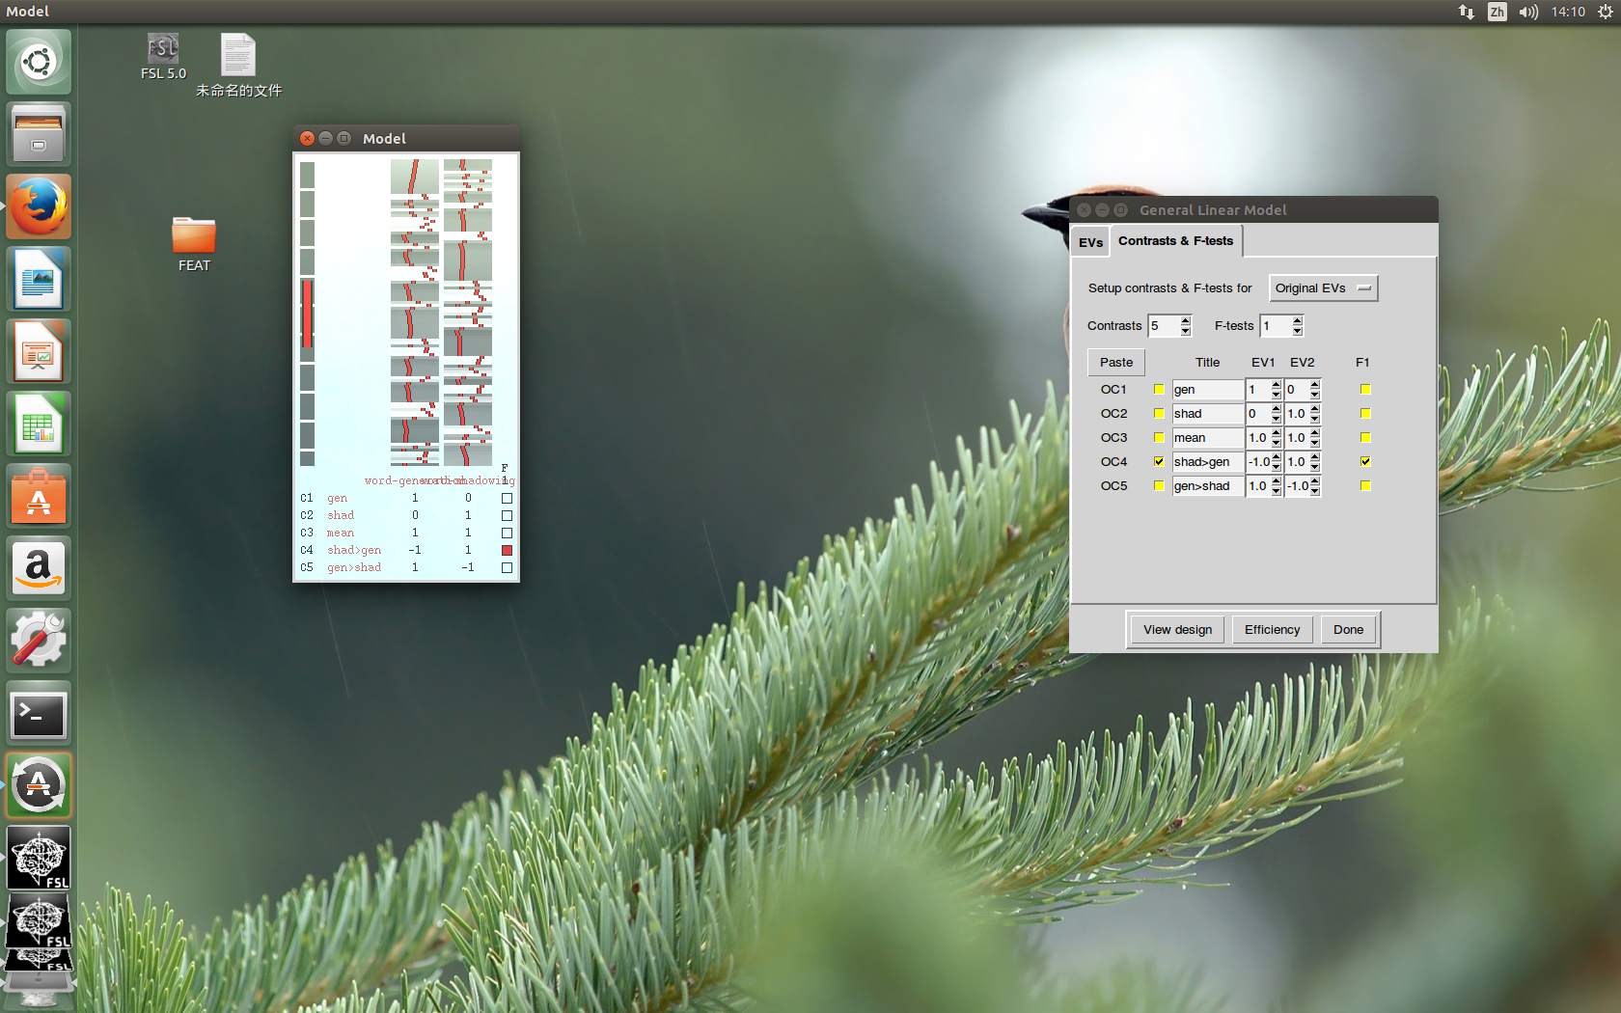
Example real fmri-fluency dataset
fmri.nii.gz
Word-generation events
Word-shadowing events

Slide 5
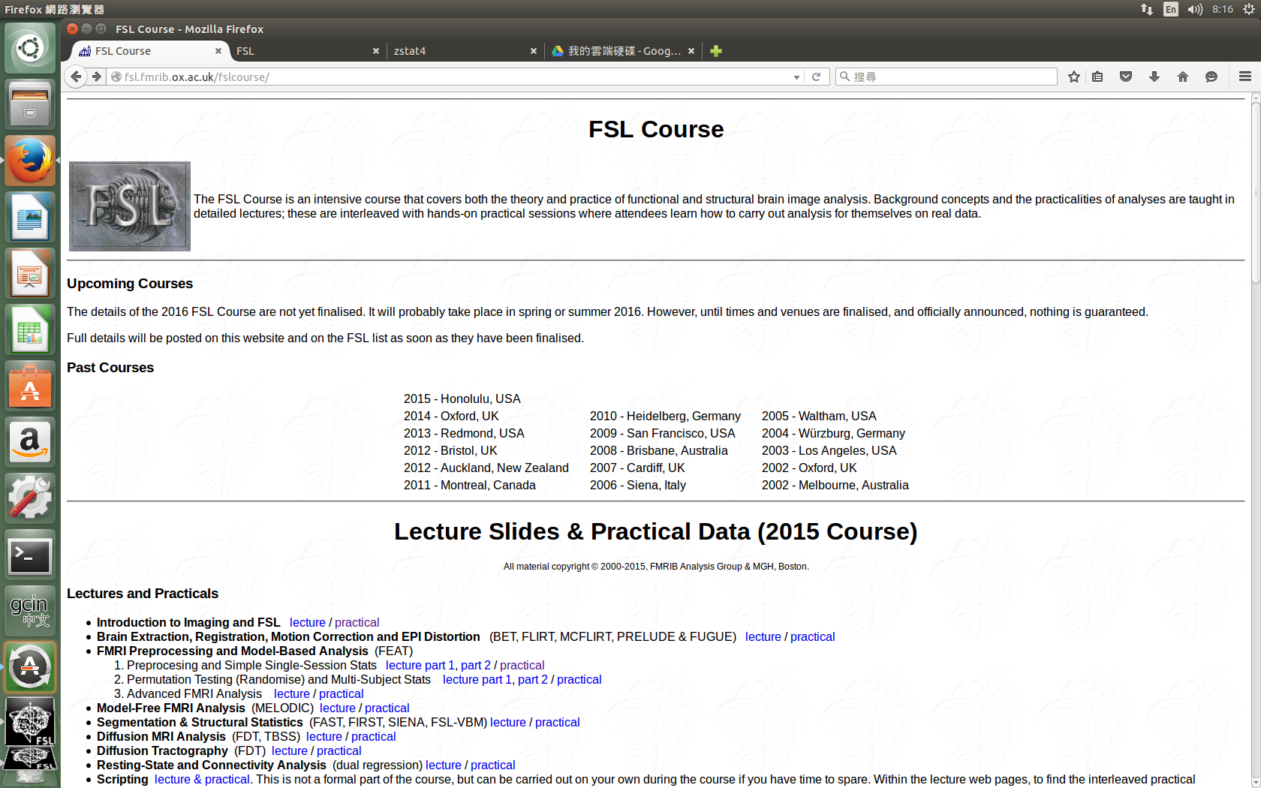
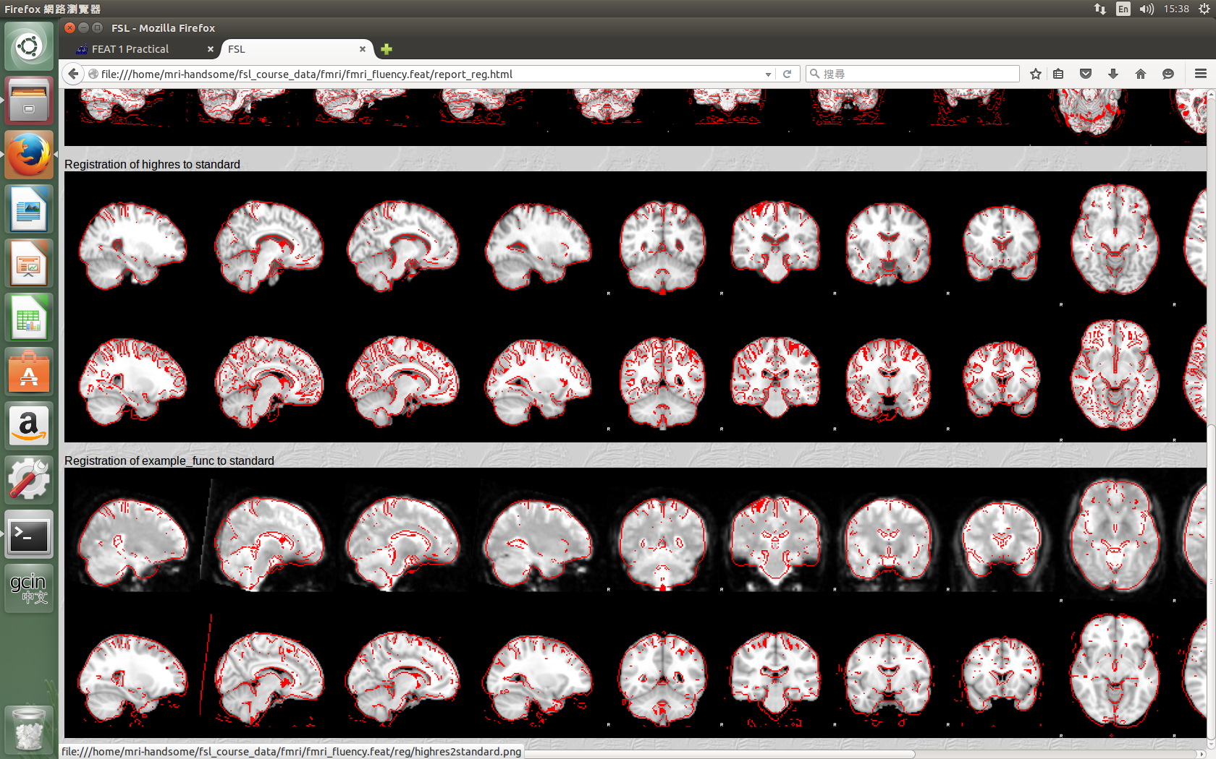

Slide 6
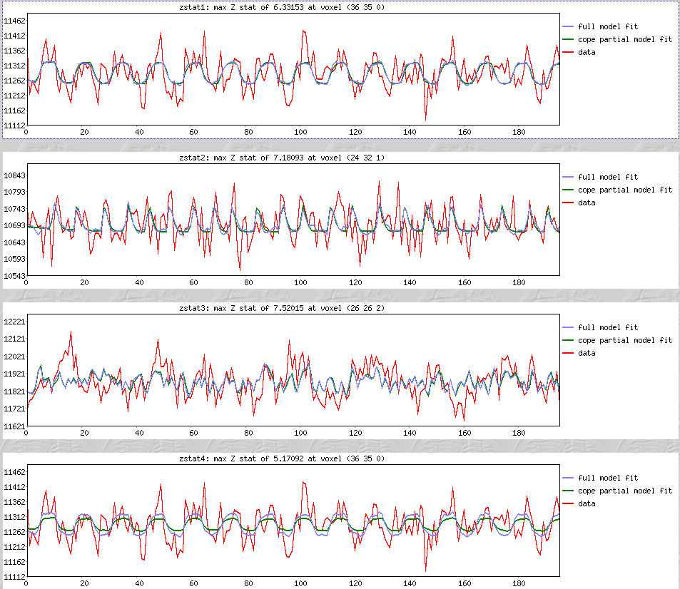
Example real fmri-fluency dataset

Slide 7
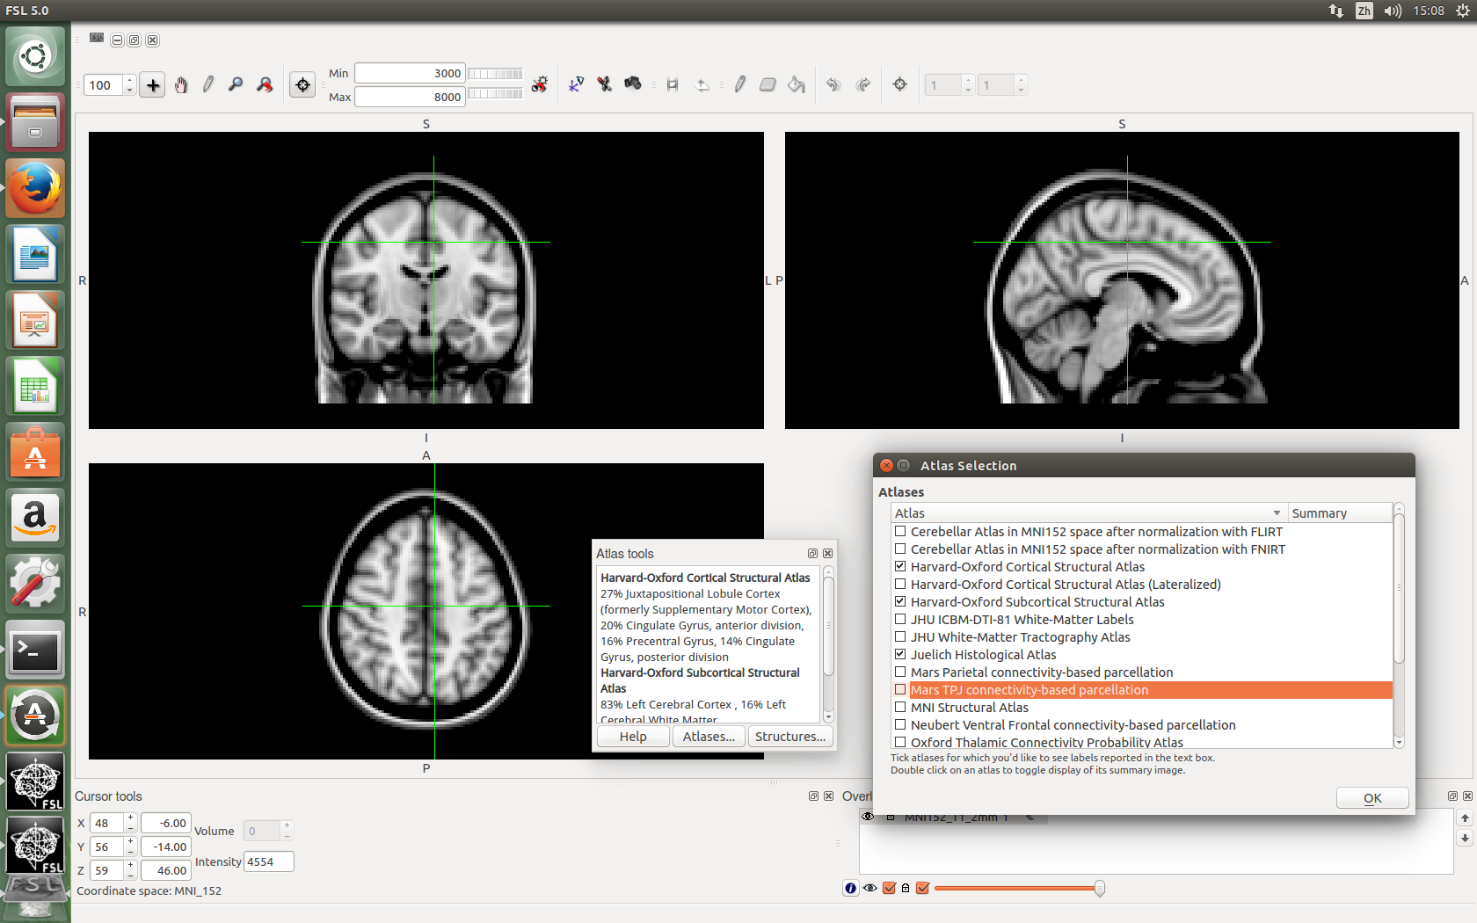
Example real fmri-fluency dataset
Tools->Toolbars->Atlas tools

Slide 8
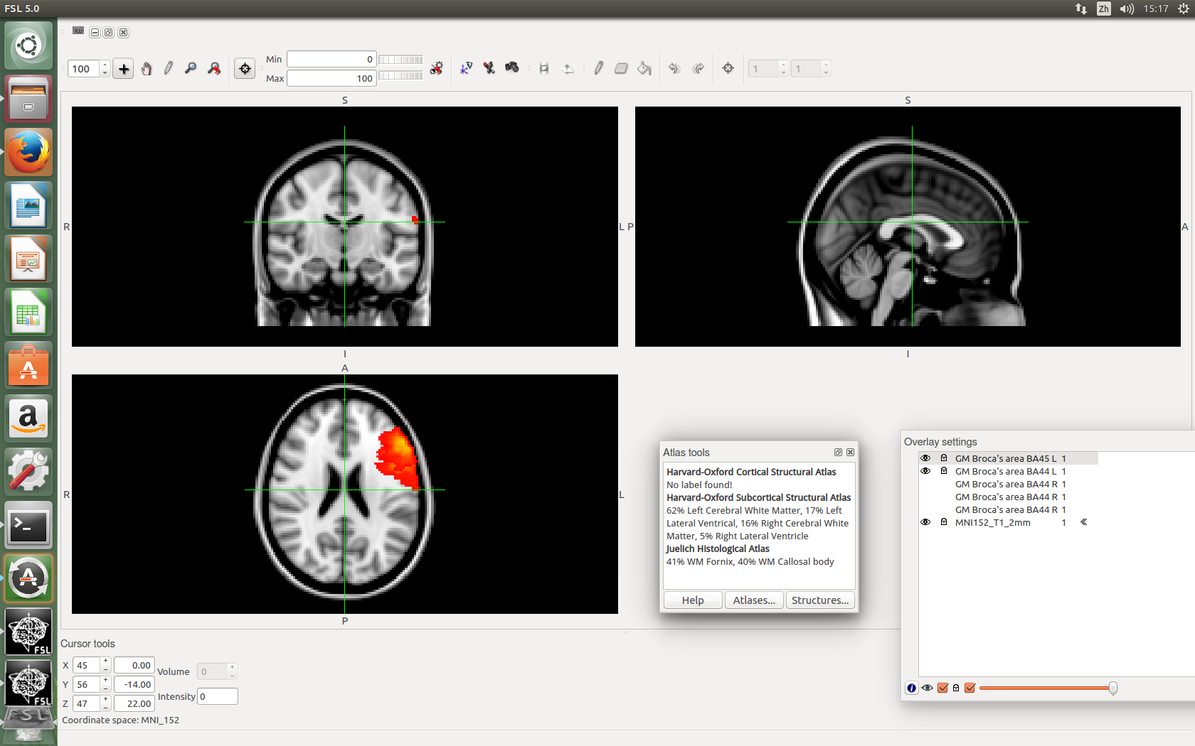
Example real fmri-fluency dataset
GM Broca's area BA44 L
GM Broca's area BA45 L

Slide 9
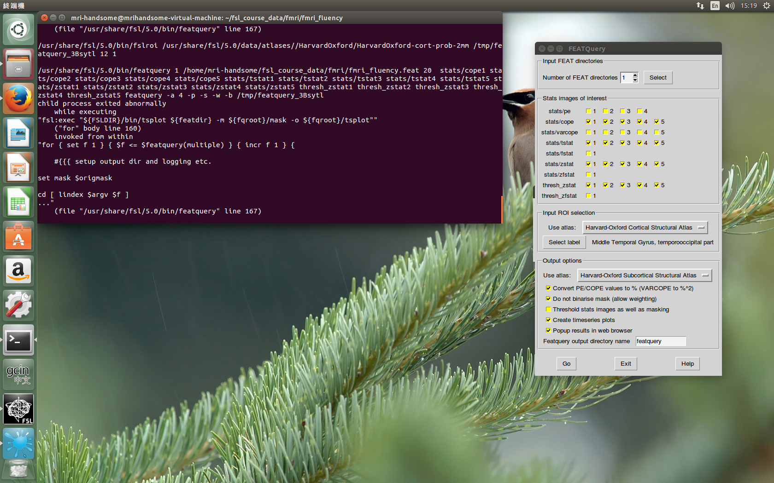
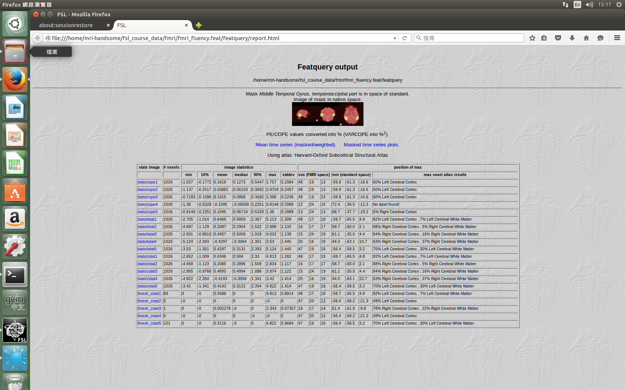
Featquery
Featquery &

Slide 10
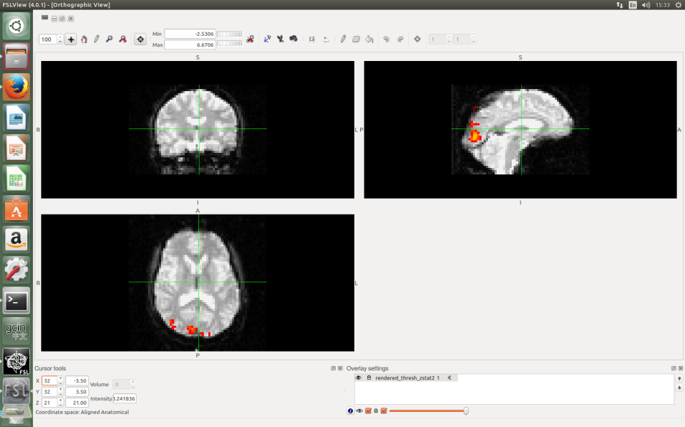
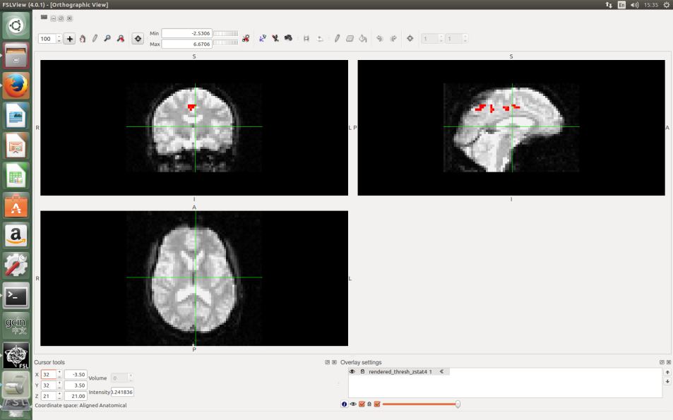
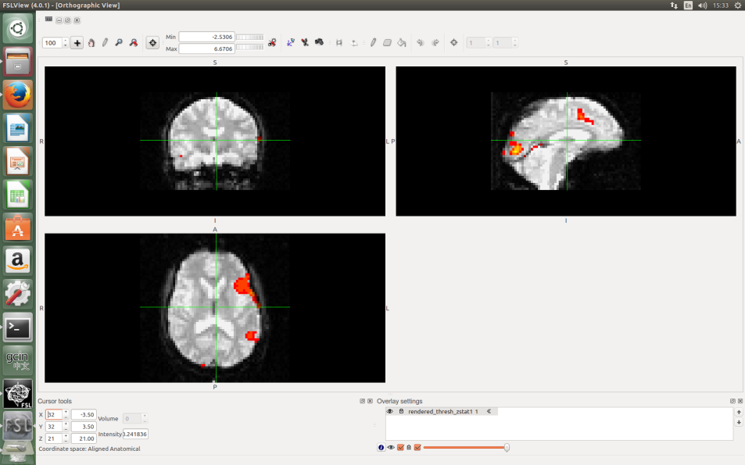
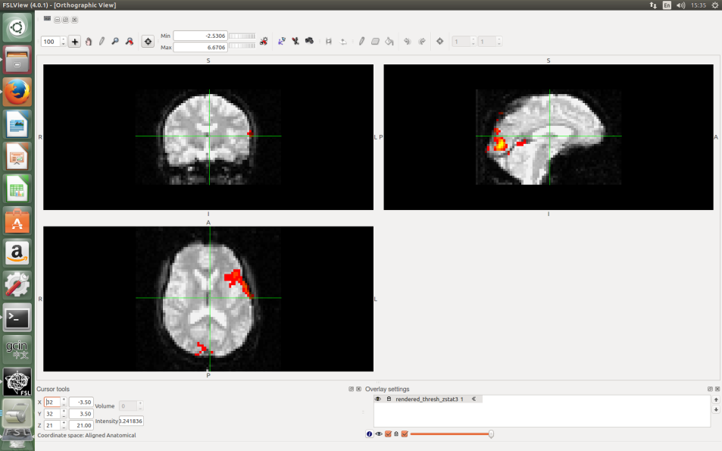
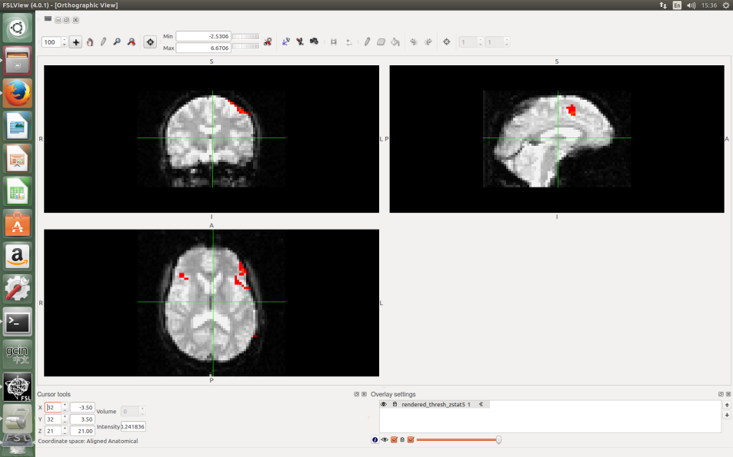
High-resolution Single-Session Overlays
Renderhighres_gui

Slide 11
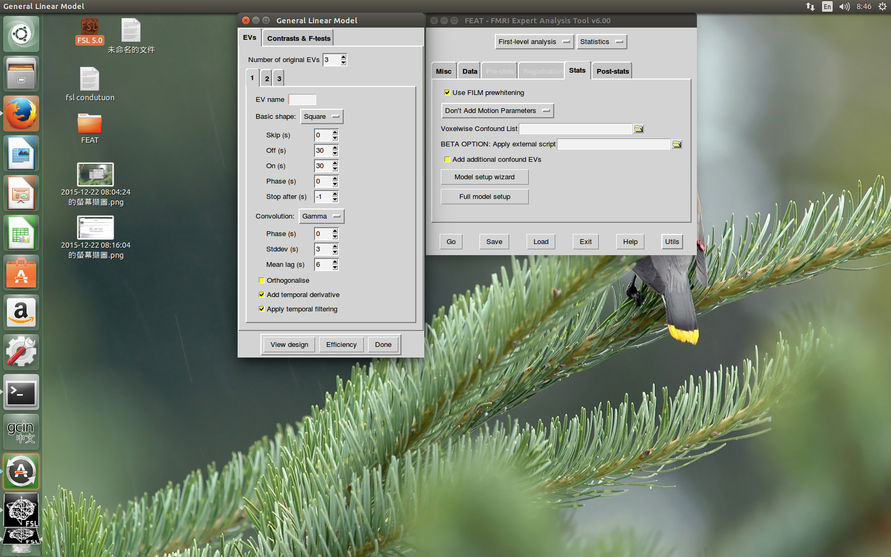
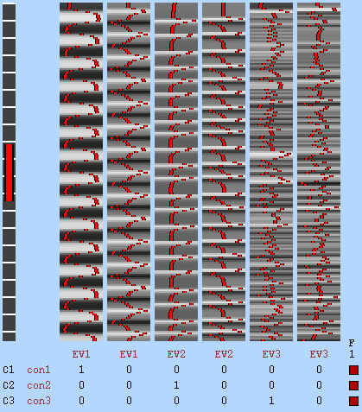
Custom Waveforms
cd ~/fsl_course_data/fmri/art
Feat &

Slide 12
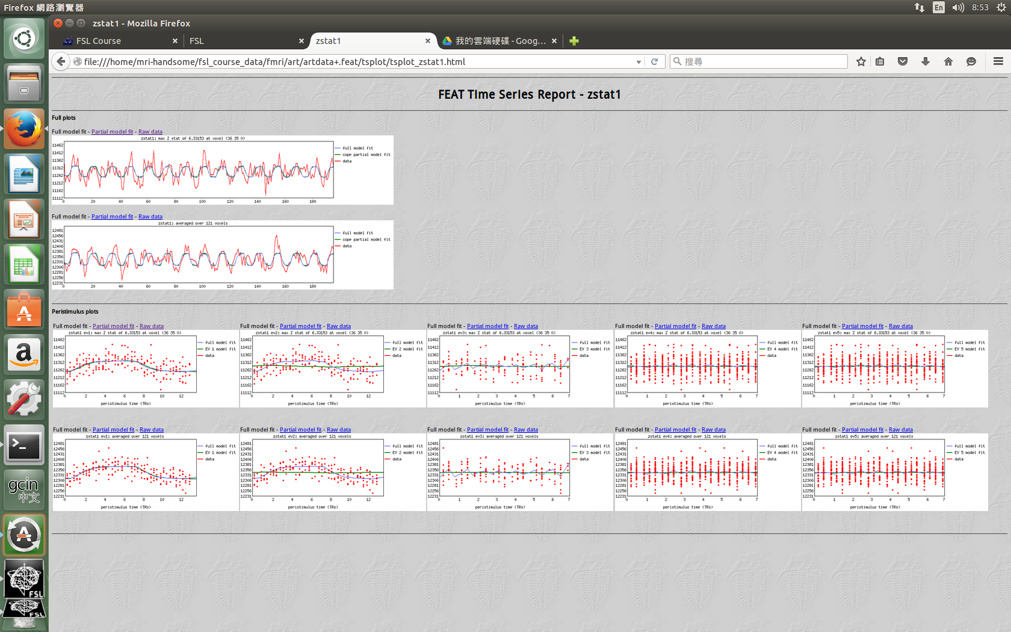
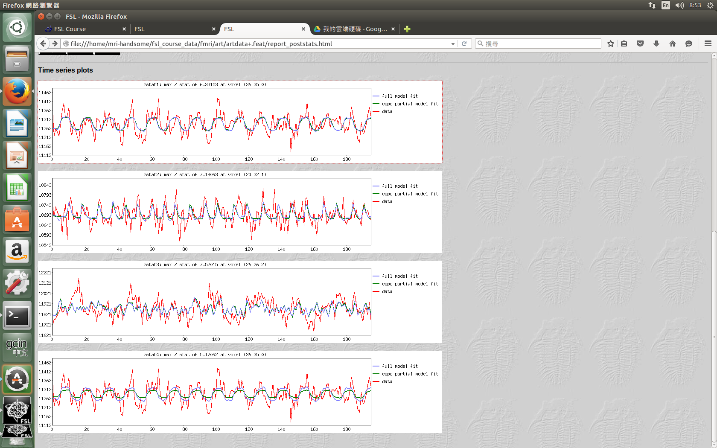
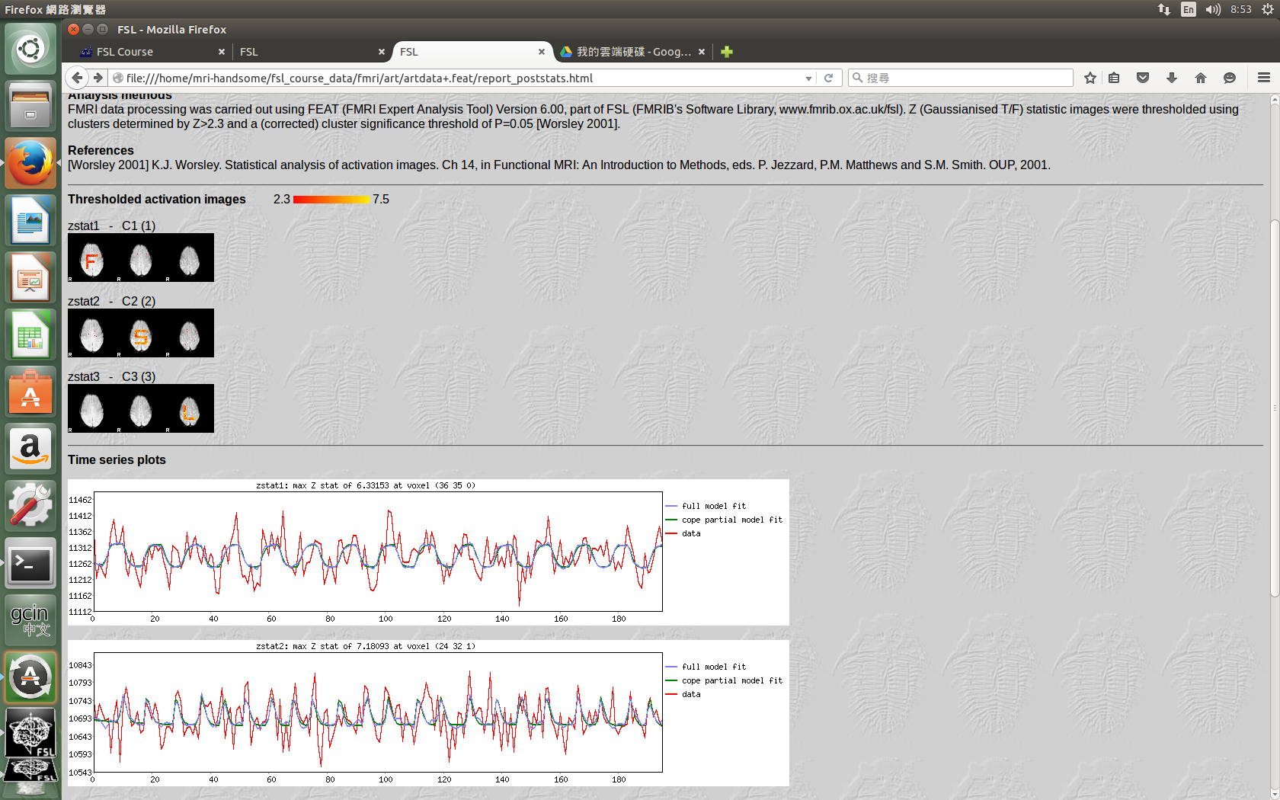
Custom Waveforms

Slide 13
The End
Thank you

